Slide 1

Human Pose Estimation
Presented by
Ahmad N. Riza (M10903807), Department of Mechanical Engineering
Jirayu Petchhan (D10907801), Department of Electrical Engineering
Notes:
Ok let’s start
Hello evyone myname is…
And another one is …
We represent to present the human pose estimation project

Slide 2
Content
Recapitulation
Dataset
Net Architecture
Preprocessing data, Loss function & Optimizer
Experimental Results
Conclusion and Future Works
Reference
Notes:
we are presenting the main 5 parts for human pose project
1st is recap from our existing work
2nd is new dataset implemented
3rd is new net architecture applied in our work
4th is process of data preprocessing, objective function and optimizer that have been implemented
and the last is output result from paper, our testing and finishing with conclusion

Slide 3
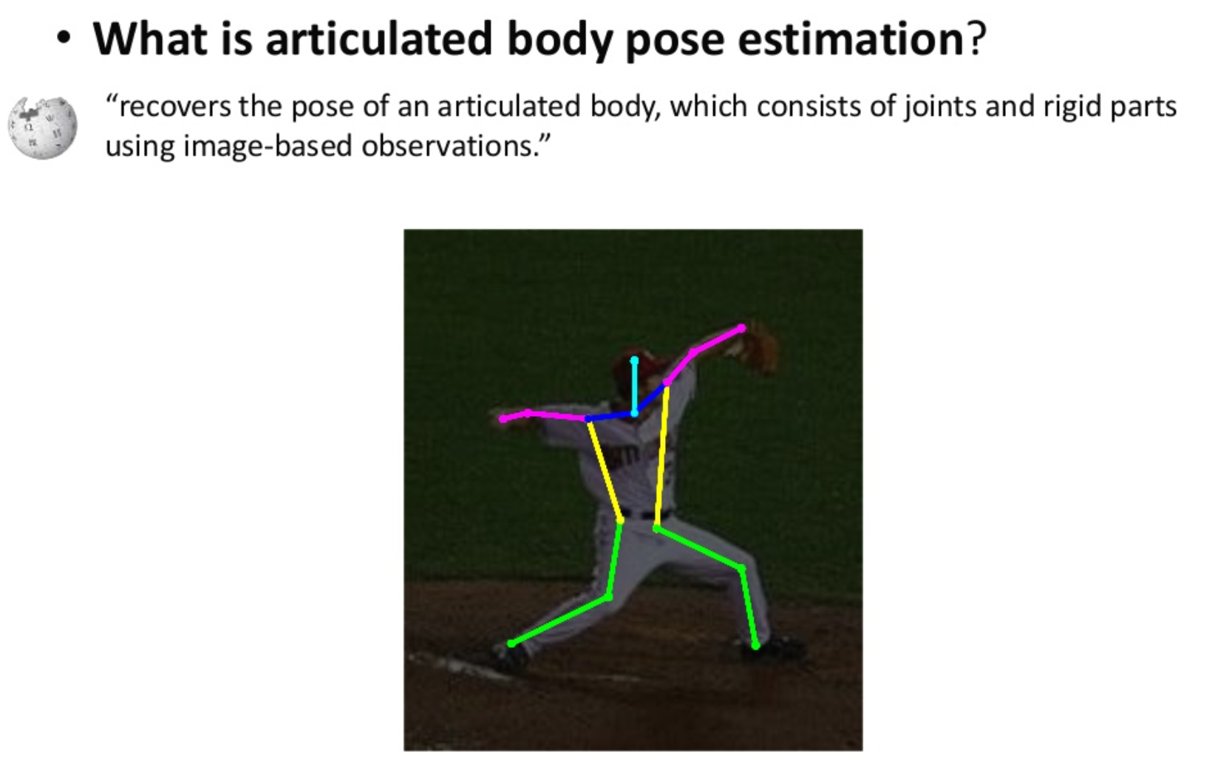
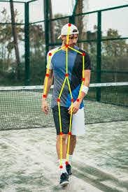
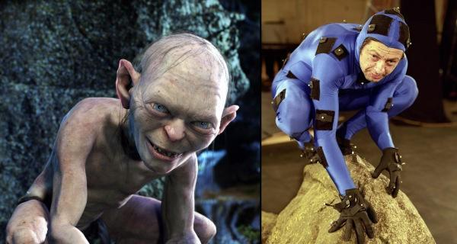
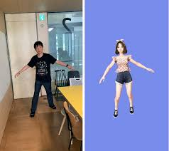
Recap: Human Pose Estimation
Notes:
Recap a little bit I will say it quickly, the last time as our project in the study of human pose estimation
the objective is defined as the problem of localization of human joints and detect keypoints of human body used for motion tracking, action recognition, animation, and so on.

Slide 4
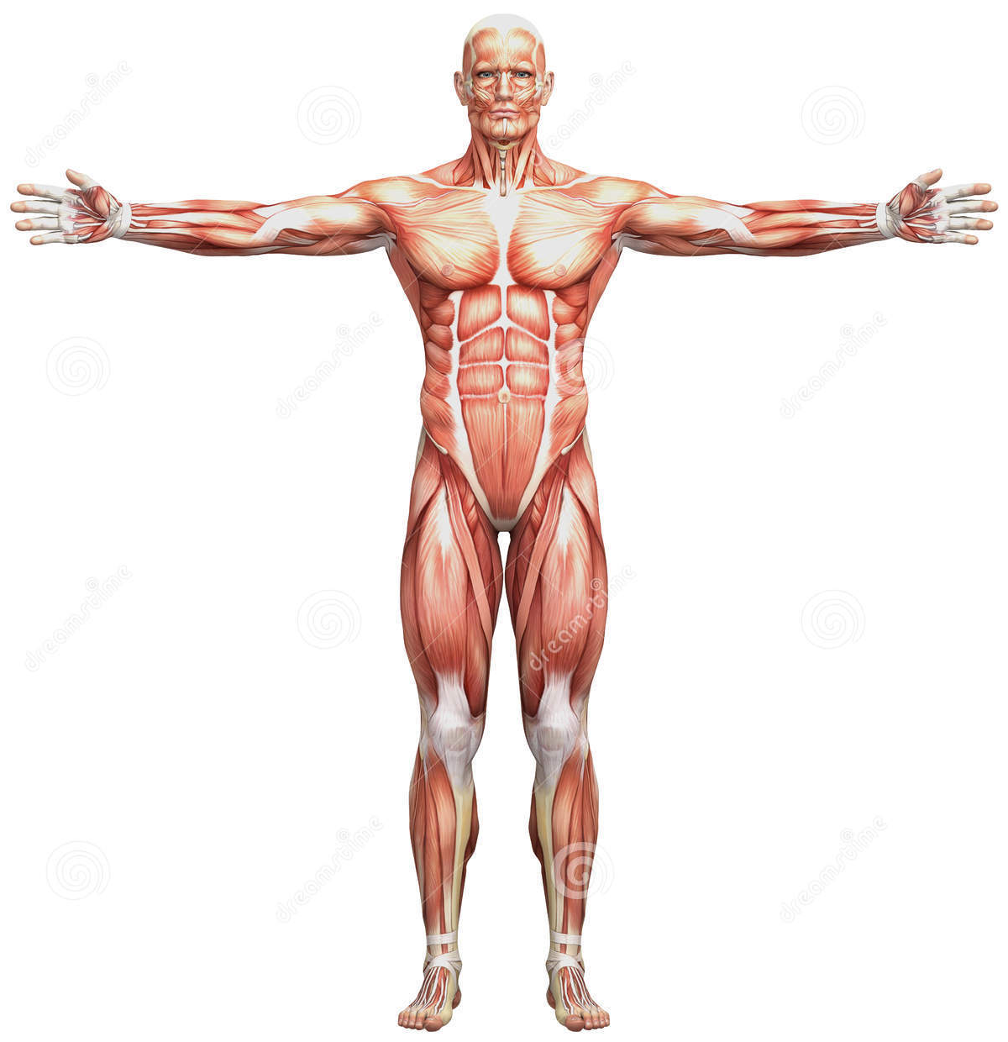
Recap: Human Body
Key Points
The keypoint task involves simultaneously detecting people and localizing their keypoint
There are 17 key points
Notes:
there are about 17 key points to be localized and detected by learning model.

Slide 5
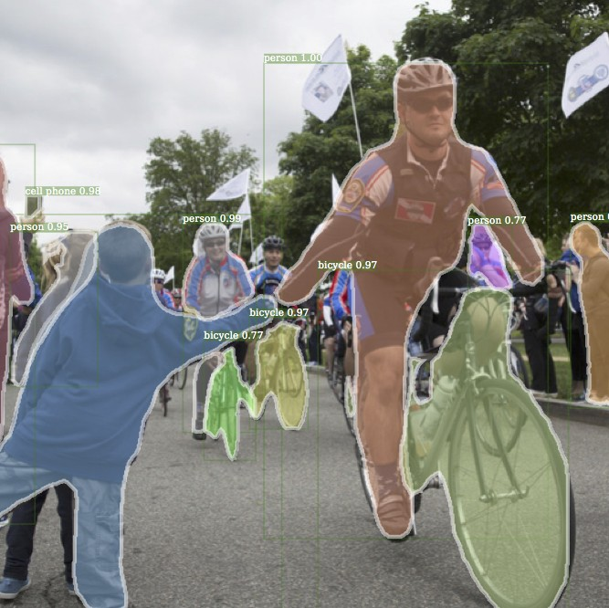
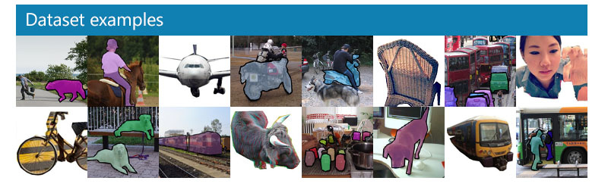
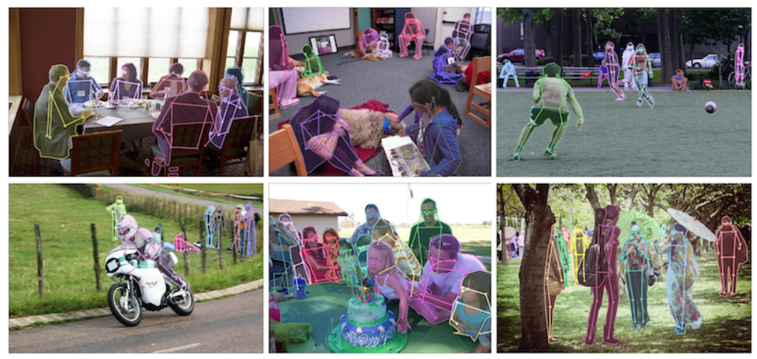

Recap: The COCO Dataset
The COCO train, validation, and test sets contain more than 200k images and 250k person instances labeled with keypoints.
The keypoint task involves simultaneously detecting people and localizing their keypoint

Slide 6

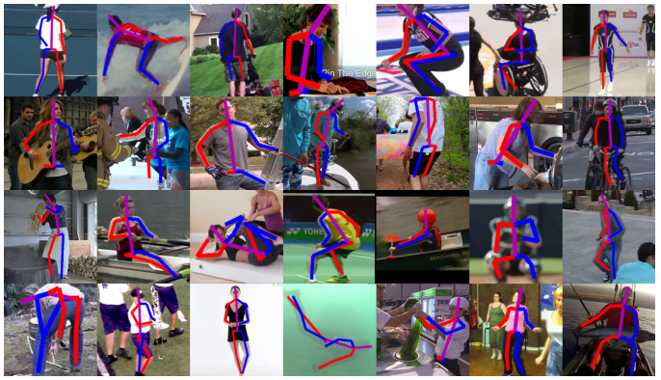
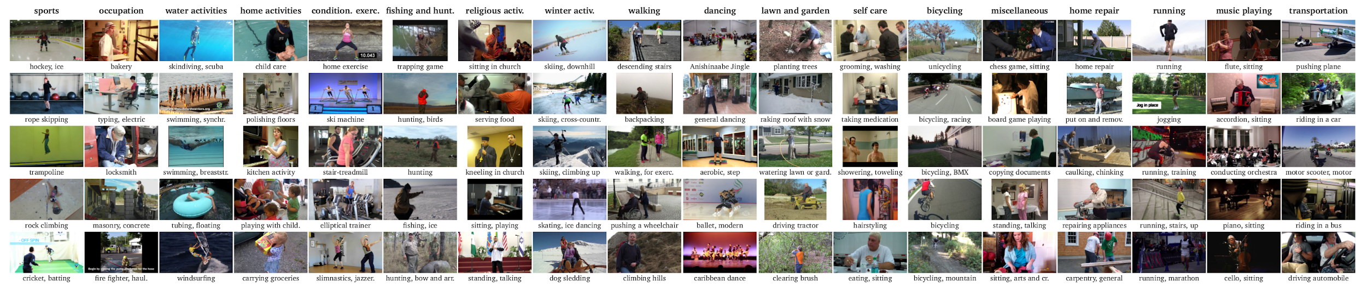
MPii Human Pose Dataset
The dataset includes around 25K images containing over 40K people with annotated body joints that overall the dataset covers 410 human activities.
The task involves the detecting people and localizing their key points.
Notes:
anyway, in this time, we have chosen another dataset for testing i.e. mpii
mpii human pose dataset includes the images about 25K images that there contain over 40k people with annotated human body joints.

Slide 7

Caffe Framework
Caffe is a deep learning framework and is built to excel at utilizing both multiple GPUs on a single-host and multiple hosts with GPUs. Moreover, Caffe is headed towards supporting more industrial-strength applications with a heavy focus on mobile.
Notes:
Moreover, additional framework have been implemented we have been testing another learning framework into our worki.e. caffe

Slide 8
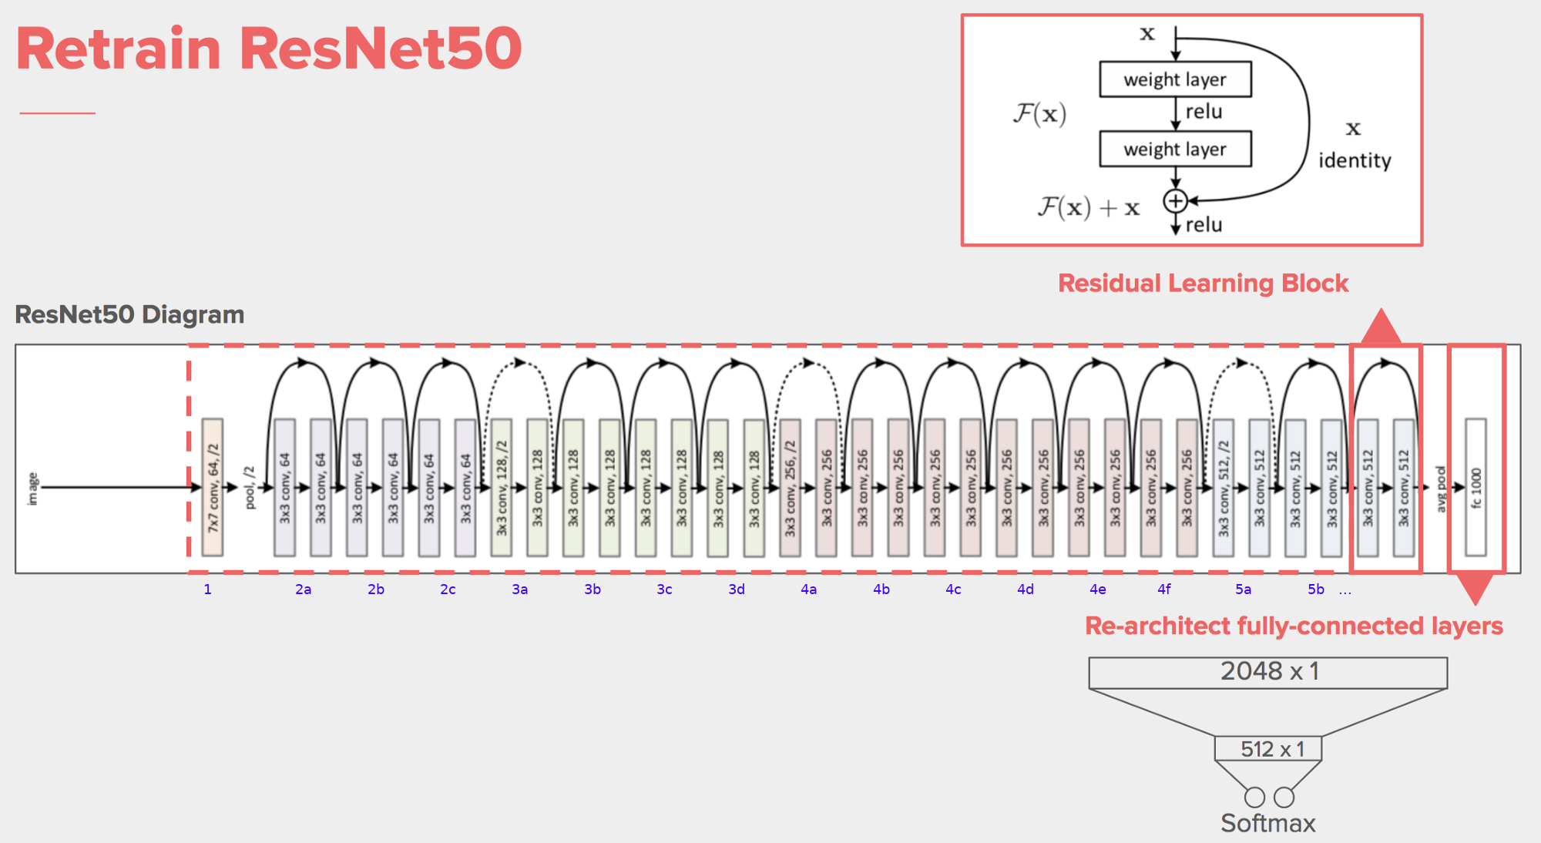
The same backbone - ResNet (50, 101, 152)
Notes:
Let’s see to the next part, net architecture
where we still use Residual Networks (i.e. ResNet) for a main backbone
———
There are two parts: the residual block layer and the re-architect layer.

Slide 9
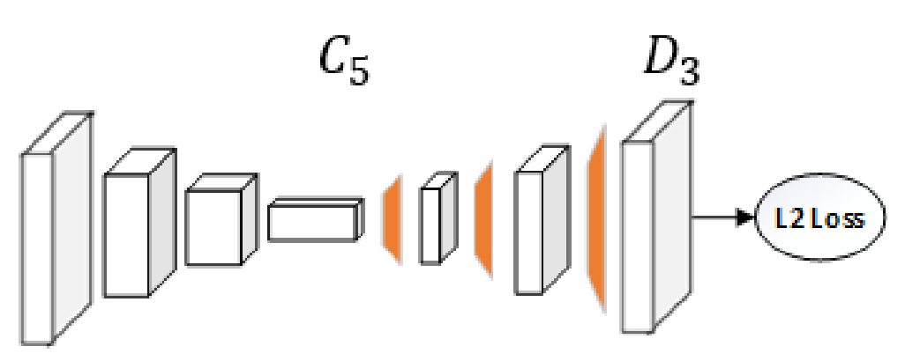
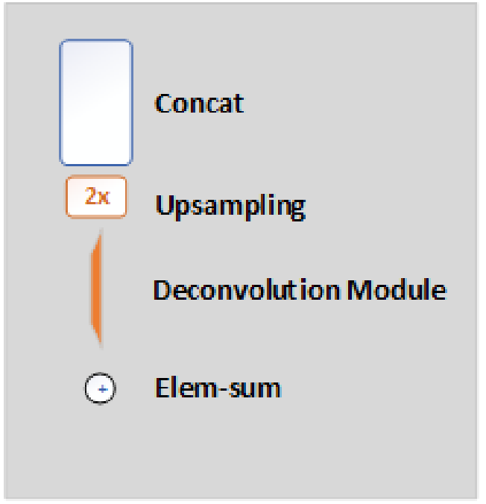
The existing: Simple Baselines Network Architecture
ResNet
Each deconvolutional layer using (batch normalization, ReLU, f=256, k=4, s=2)
Deconvolutional layer following by 1x1 convolutional layer
Notes:
By the midterm, we use Simple baseline net from microsoft including resnet as backbone for processing human body pose images.

Slide 10
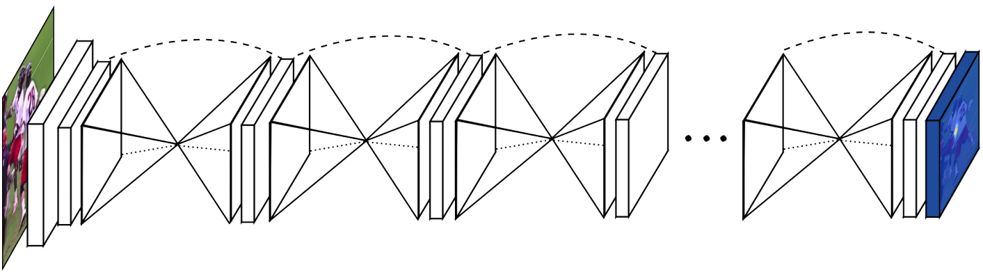
Network Architecture: Stacked HourGlass
Notes:
In This time, we have been adding whole another network for testing along with the existing net i.e. Stacked HourGlass ARCHITECTURE
This network is for human pose processing. By the hourglass study consists of multiple stacked hourglass modules which allow for repeated bottom-up, top-down inference.

Slide 11
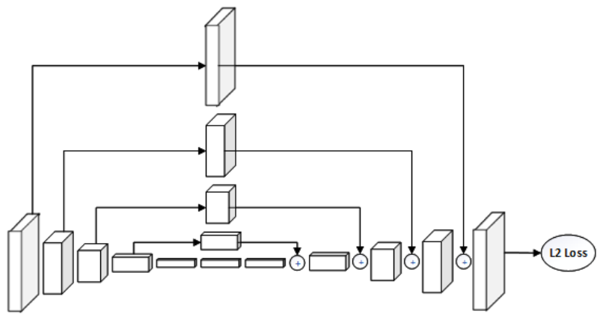
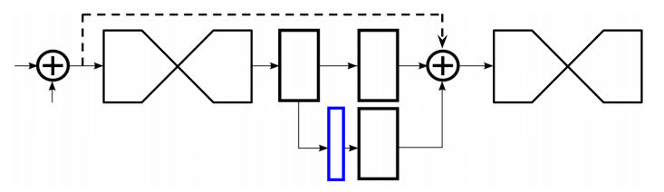
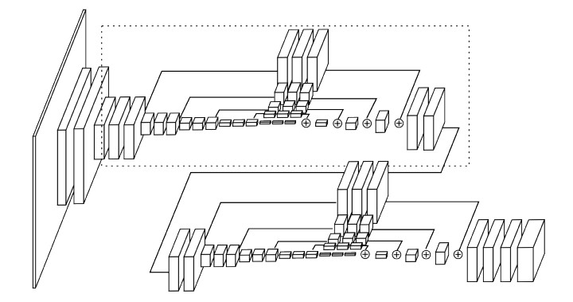
Single HourGlass Architecture
Residual Module is applied and implemented throughout this network.
The network splits and produces a set of heatmaps (outlined in blue) from residual module.
Notes:
Anyway, We will go into detail of the network in single Hourglass before stacking for the first.
This study have inspired to implement residual module in their architecture
this architecture don’t use unpooling or deconv layers but rely on simple upsampling and skip connections for top-down processing.
In general, Convolutional and max pooling layers are used to process features down. But at each max pooling step, the network branches off and applies more convolutions at the original pre-pooled resolution. The network splits and produces a set of heatmaps (outlined in blue)
Deconv resize bigger that work with filter kernel size stride
But upsampling it kind of only resize image and not work with filter stride i.e. unpooling revert from maxpool

Slide 12

Stacked HourGlass Network
1st HG
L2 Loss
2nd HG
Stacking two of their HourGlass networks after each other. Between them they place an intermediate loss. That way, the second network can learn to improve the predictions of the first network.
Notes:
so when connecting multiple networks of HG
the loss have been calculated and place to implement and connect into the next network i.e. 2nd HG. the network can learn to reduce the loss again and make more accuracy for prediction rather than from first HG net.

Slide 13
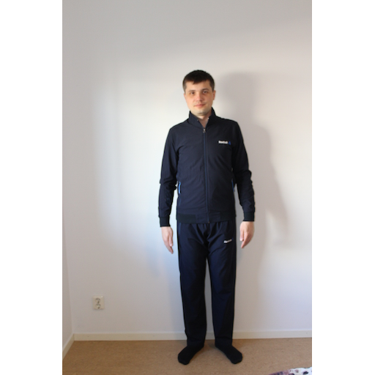
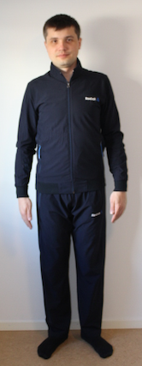
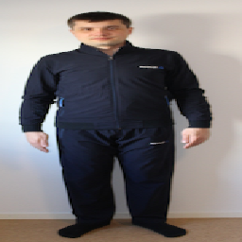
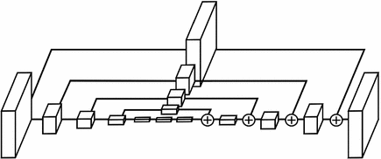
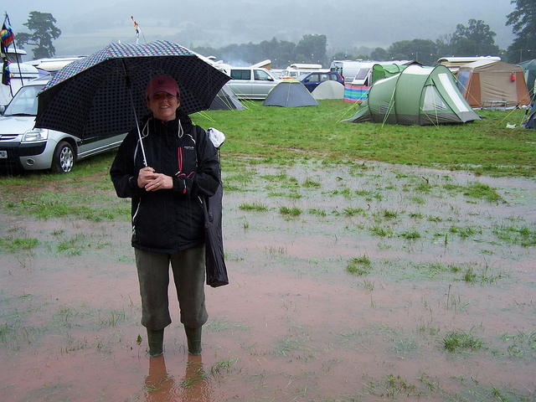
Data pre-processing (Augmentations)
Data Augmentation
Network Architecture
The augmentation data set contain scales(±30%, 0.75-1.25), rotates(±30 degrees), horizontal flip and resized to 256x256 pixels.
Faster R-CNN
Notes:
by the way, data pre-processing have been done first
the images have to be done with data augmentation by region proposal from Faster RCNN that contain cropping images, scaling (in range 30%), rotating (plus,minus 30degs), horizontal flipping and resizing to be 256x256 pixels all the time.
no translation augmentation bcuz the study care the location of human body that be important point to annotate in this net

Slide 14
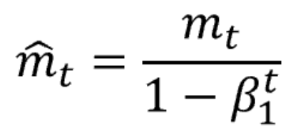
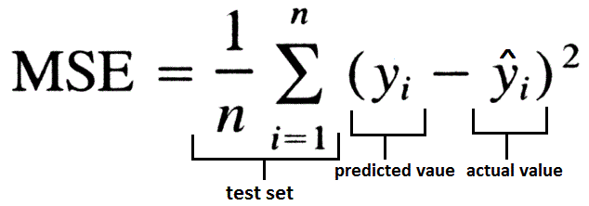
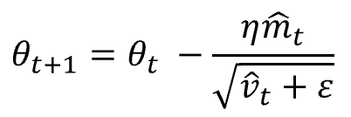
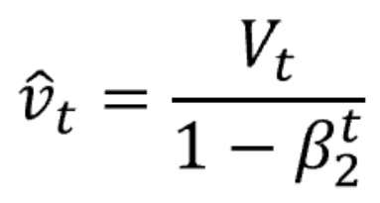
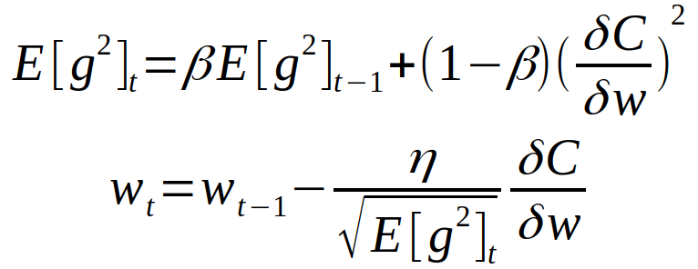
Loss Function & Optimizer
bias corrected est.
1st moment
Heatmaps classifier
bias corrected est.
2nd moment
predicted heatmaps
targeted heatmaps
Loss Function - Joint L2 Mean Square Error (MSE)
Optimizer - Adaptive Moment estimation (Adam)
Gradient squared
RMSprop added
Notes:
MSE is used as the loss between the predicted heatmaps and targeted heatmaps. The targeted heatmaps H_{k} for joint k is generated by applying a 2D gaussian centered on the k^{th} join’s ground truth location

Slide 15
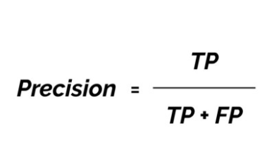
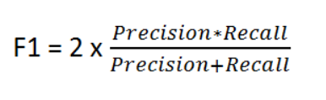
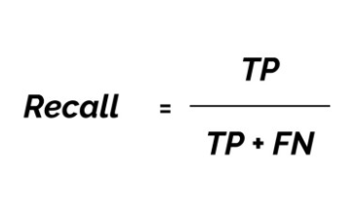
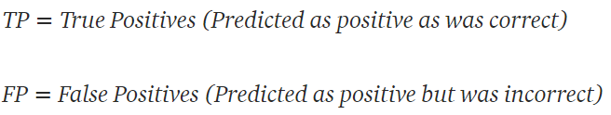
Validation Method
How many selected items are relevant
How many relevant items are selected
F1 is used to seek the balance between precision and recall
Very useful when we have imbalanced classes

Slide 16
Paper - Experimental Setup - Simple Baseline
Parameters | ResNet50 | ResNet101 | ResNet152 | ResNet with caffe
Batch Size | 32 | 32 | 32 | 32
Epoch Number | 140
Learning Rate | E=0-9 := 1e-4 / E=10-14 := 1e-5 / E=15-20 := 1e-6
Optimizer | Adaptive Moment estimation (Adam)
Loss Function | Joint MSE
Pretrained Model | No
Remark E = number of step in epochs
The mentioned setting referred from a paper.

Slide 17
Our Testing - Experimental Setup - Simple Baseline
Parameters | ResNet50 | ResNet101 | ResNet152 | Resnet 50 - Caffe | Resmet 101 - Caffe | ResNet152 - Caffe
Batch Size | 32 | 50 | 40 | 32 | 32 | 32
Epoch Number | 20
Learning Rate | 0.001
Optimizer | Adaptive Moment estimation (Adam)
Loss Function | Joint MSE
Pretrained Model | Yes
The model is trained by using pretrained model
Batch size is depending on the GPU

Slide 18
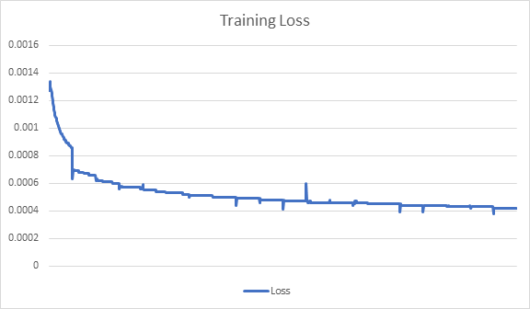
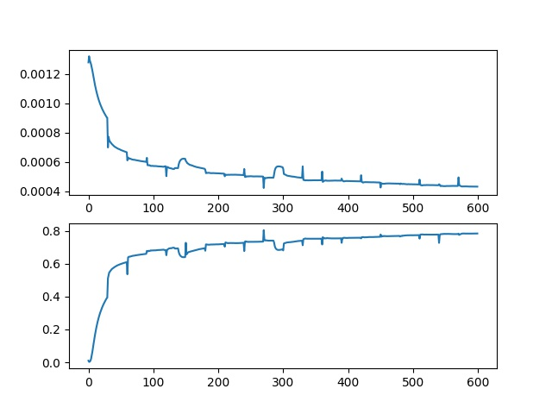
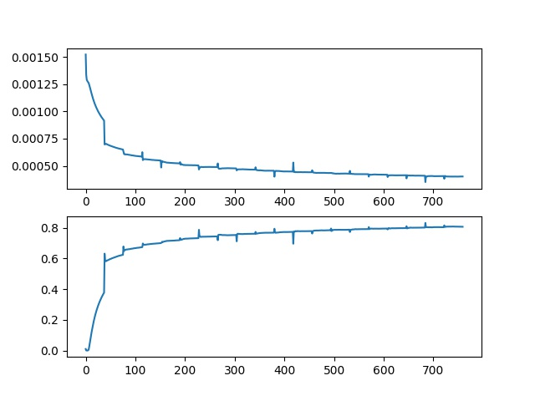
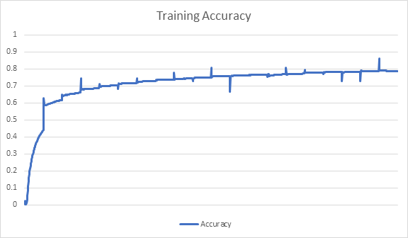
Training Result - COCO 2017 (Simple Baseline)
ResNet50 | ResNet101 | ResNet152

Slide 19
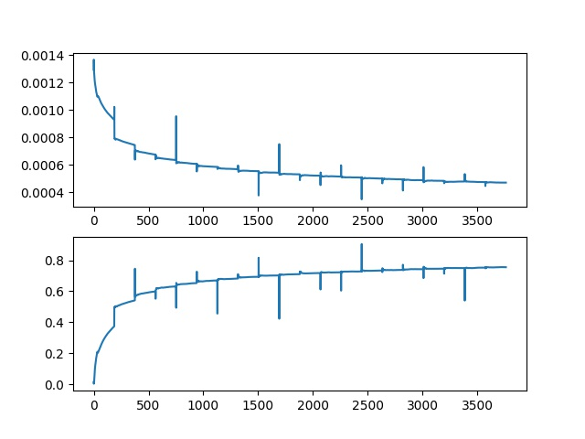
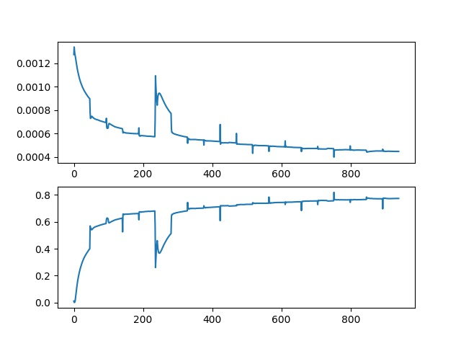
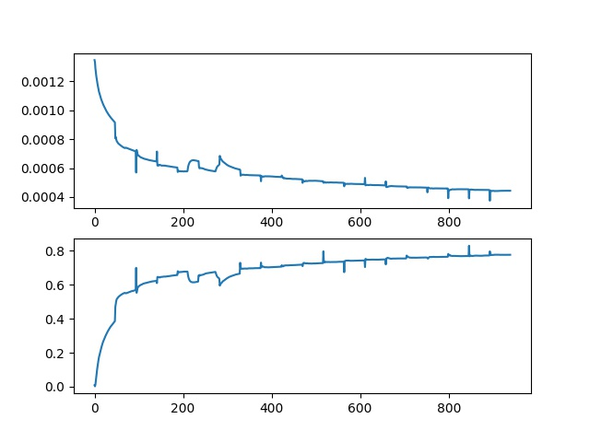
Training Result - COCO 2017 (Simple Baseline)
ResNet50 using Caffe | ResNet101 using Caffe | ResNet152 using Caffe
Notes:
Top is Loss and bottom is accuracy

Slide 20
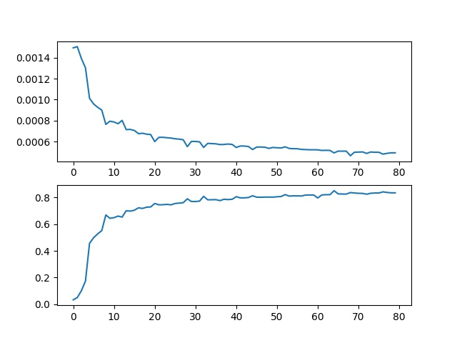
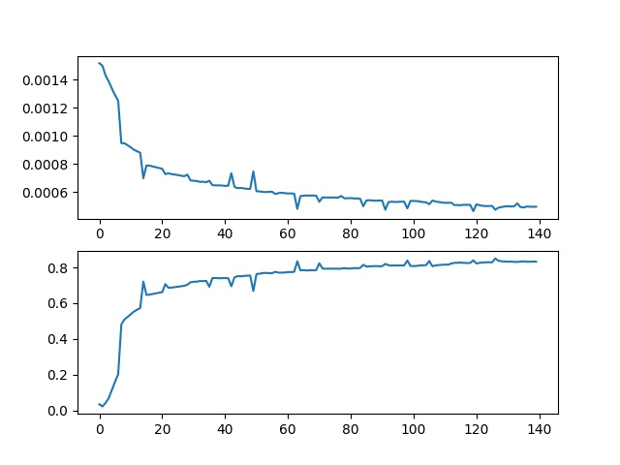
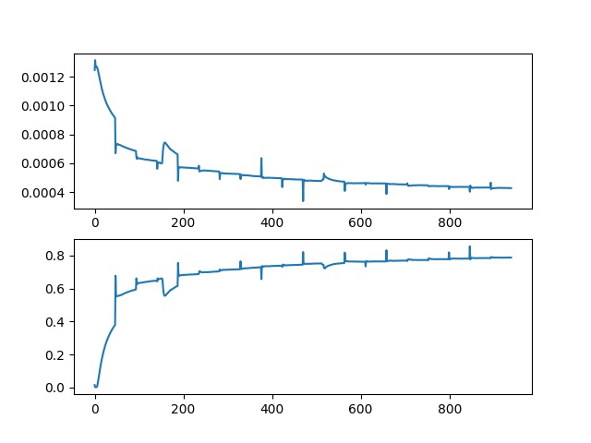
Training Result - MPII (Simple Baseline)
ResNet50 | ResNet101 | ResNet152
Notes:
Top is Loss and bottom is accuracy

Slide 21
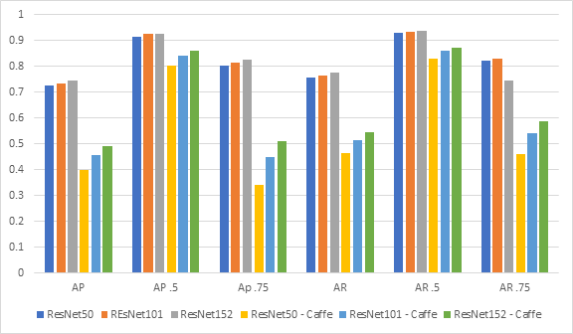
Validation Result - COCO dataset
AP = Average Precision
AR = Average Recall
Deeper network given better result
Notes:
All of resnet with caffe was trained without any pretrained model

Slide 22
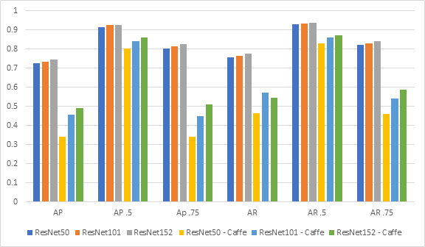
Test Result - COCO dataset
AP = Average Precision
AR = Average Recall
Deeper network given better result

Slide 23
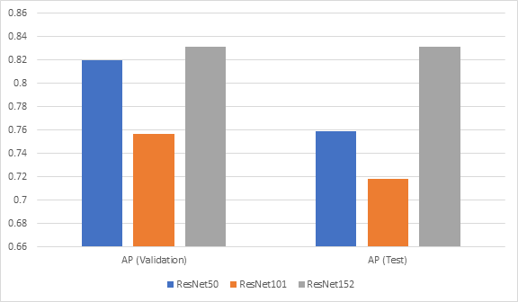
Result - MPII dataset (8 - Stage Hourglass)
AP = Average Precision
AR = Average Recall
Deeper network given better result

Slide 24
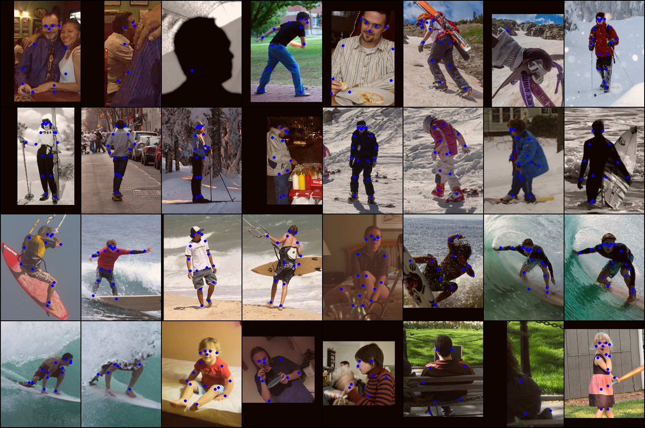


Validation Result
ResNet50
ResNet101
ResNet152

Slide 25
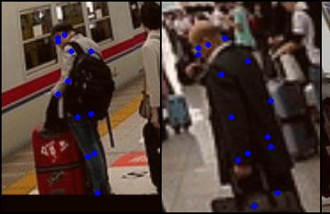
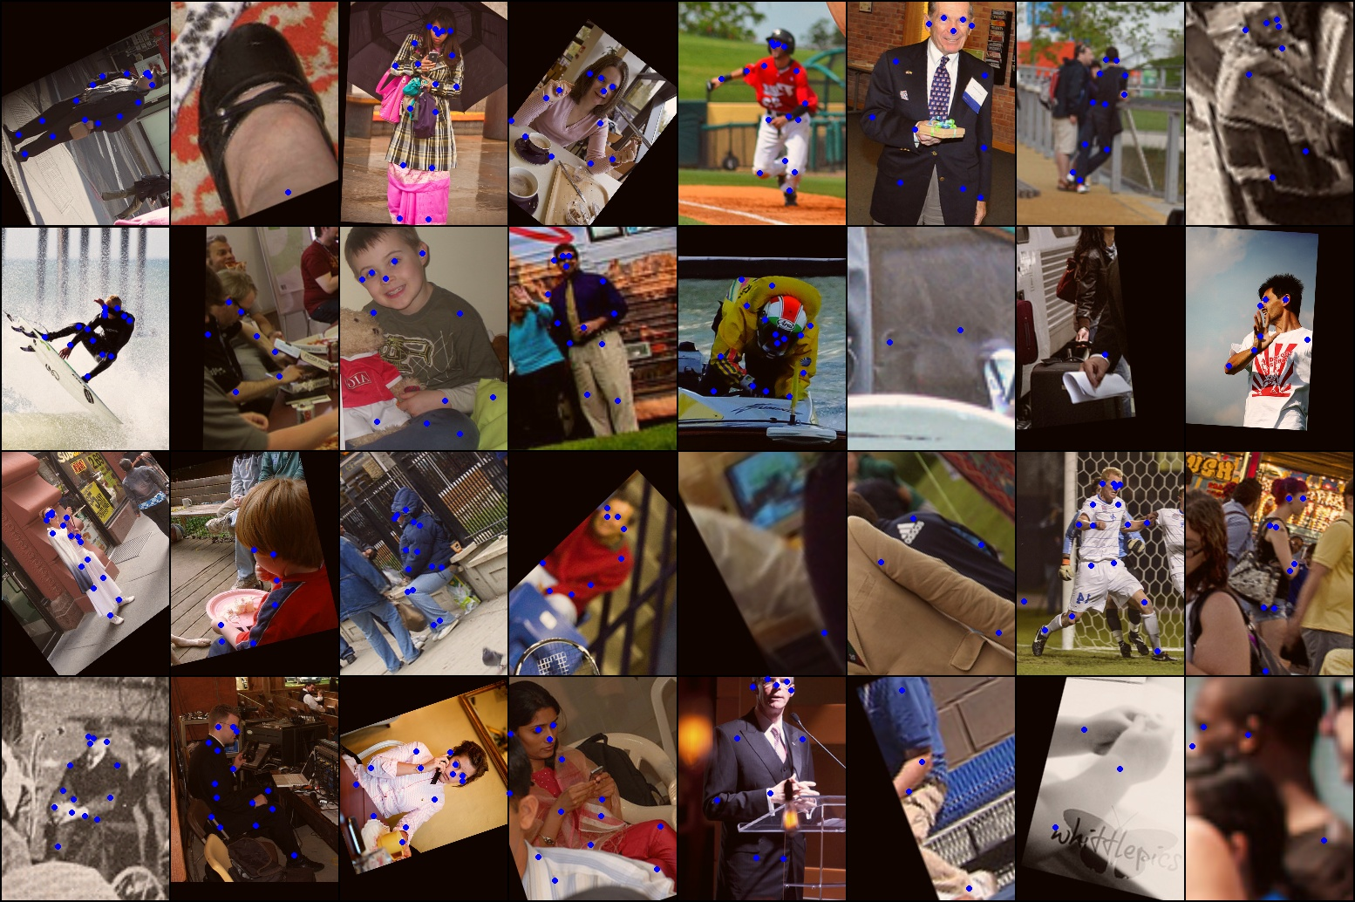
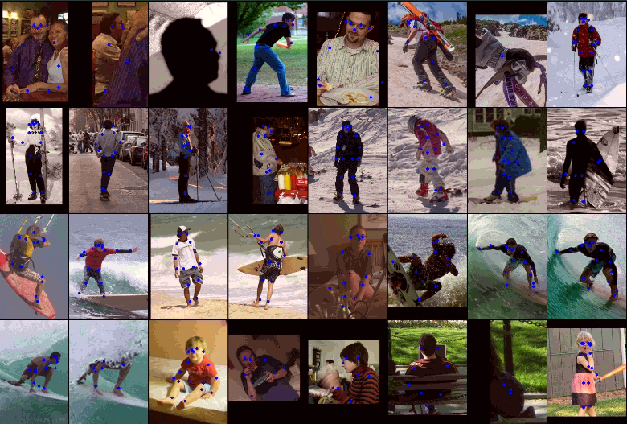
Validation Result
ResNet50 with Caffe
ResNet101 with Caffe
ResNet152 with Caffe

Slide 26
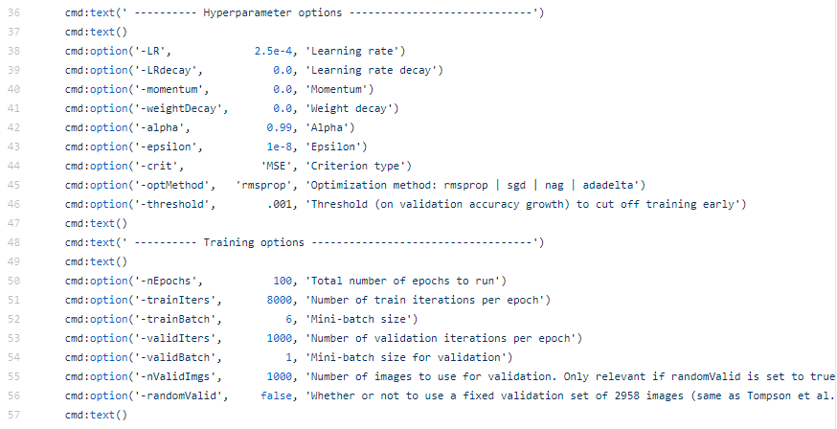
Paper - Experimental Setup - HourGlass
Parameters | 8-stage HourGlass
Batch Size | 6
Epochs / Iterations | 500 / 8,000
Learning Rate | 2.5e-4
Decay Rate | 0.0002
Optimizer | RMSprop
Loss Function | MSE
The mentioned setting referred from a paper

Slide 27
Our Testing - Experimental Setup - HourGlass
Parameters | 8-stage HourGlass
Batch Size | 8
Epoch Number | 100
Learning Rate | 0.001
Optimizer | Adam
Loss Function | MSE
The model is trained by using pretrained model
Batch size is depending on the GPU

Slide 28
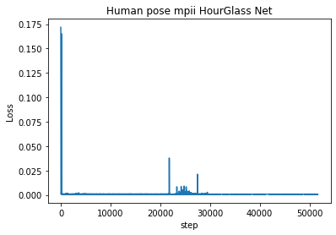
Training Result - MPII (Stacked Hourglass)
Obtained Average Precision (AP) 0.5905 (for test) and 0.7622 (for validation)
Notes:
Top is Loss and bottom is accuracy

Slide 29

Results Comparison
Paper result
Our result
Notes:
Based on some discussion in github, they told that the model of resnet from caffe and pytorch are different. In pytorch they do downsample part in each block/layer with conv3x3 using stride 2 while on official caffe version they use conv1x1 with stride 2. Maybe because of this reason, the resnet caffe perform not good

Slide 30
Conclusion
The result shows that simple baseline give better result
The Stacked Hourglass net can make more accuracy when stacking network.
This HG network is quite complexity rather than Simple Baselines since there are split out two times from residual block i.e. 1st time to retain weight by natural residual block. and 2nd time to produce heatmaps

Slide 31
Reference
Bin Xiao et al., “Simple Baselines for Human Pose Estimation and Tracking”, in ECCV 2018, DOI: https://arxiv.org/abs/1804.06208. Github: https://github.com/microsoft/human-pose-estimation.pytorch.
Alejandro Newell et al., “Stacked Hourglass Networks for Human Pose Estimation”. in Computer Vision and Pattern Recognition (cs.CV). DOI: arXiv:1603.06937. Github: https://github.com/princeton-vl/pytorch_stacked_hourglass.
https://cocodataset.org/#home
https://towardsdatascience.com/an-overview-of-resnet-and-its-variants-5281e2f56035
https://towardsdatascience.com/breaking-down-mean-average-precision-map-ae462f623a52
Max planck institut informatik. MPII Human Pose Dataset. [Online]. Available: http://human-pose.mpi-inf.mpg.de/
Facebook. Caffe 2 Framework. [Online] Available: https://caffe2.ai/blog/2018/05/02/Caffe2_PyTorch_1_0.html.

Slide 32


Slide 33


Validation - Object Keypoint Similarity (OKS)
Evaluation metrics that contain of average precision and average recall (similar concept to IoU in object detection)
Used to measure how close the detected keypoint is to the ground truth
The value range is 0 to 1
Common threshold are 0.5 and 0.75
Notes:
The OKS metric shows ONLY how close is predicted keypoint to the true keypoint (value from 0 to 1).

Slide 34

Results Comparison
Notes:
Top is Loss and bottom is accuracy

Slide 35
New Challenge and Future Works
The studying of HR-Net model (Developed by Simple Baselines Human Pose publisher-Microsoft)

Slide 36

Validation Result
AP = Average Precision
AR = Average Recall
Deeper network given better result

Slide 37
Training Result
Model | Heatmaps
ResNet50
ResNet101
ResNet152

Slide 38


Faster R-CNN
Faster R-CNN consists of the RPN and a Fast R-CNN detector
"the RPN module tells the Fast R-CNN module where to look."

Slide 39
Human Pose Estimation
Defined as the problem of localization of human joints
The main goals is to detect keypoints of human body
Used for motion tracking, action recognition, animation, game, augmented reality, etc.

Slide 40

Eucledian Distance

Slide 41


Accuracy Vs F1

Slide 42

OKS

Slide 43
Validation Result
Model | AP | AP_{.5} | AP_{.75} | AR | AR_{.5} | AP_{.75} | Accuracy
ResNet50 | 0.625 | 0.873 | 0.693 | 0.661 | 0.883 | 0.630 | 0.784
ResNet101 | 0.624 | 0.872 | 0.693 | 0.659 | 0.882 | 0.721 | 0.789
ResNet152 | 0.648 | 0.883 | 0.726 | 0.685 | 0.895 | 0.751 | 0.821
Deeper network given better result

Slide 44


Slide 45

The study result-HourGlass
MPii tested by stacked HourGlass networks
Results on MPII are between 80.6% (ankle) and 97.6% (head). Average is 89.4%.
Using two stacked HourGlass networks performs around 3% better than one HourGlass network (even when adjusting for parameters).

